Slide 1





THE ROLE OF
PERSONAL SELLING
IN BANGLADESH READY -MADE GARMENTS INDUSTRY
PRESENTED BY MD. SABBIR HOSSAIN

Slide 2












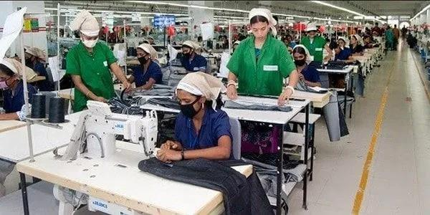



RMG
INTRODUCTION
The Ready-Made Garments (RMG) industry is a critical driver of Bangladesh’s economy, representing over 80% of the country’s total export revenue. Since the 1980s, the RMG sector has propelled Bangladesh to the position of the second-largest garment exporter in the world.The industry provides employment for approximately 4.4 million workers, the majority of whom are women.

Slide 3




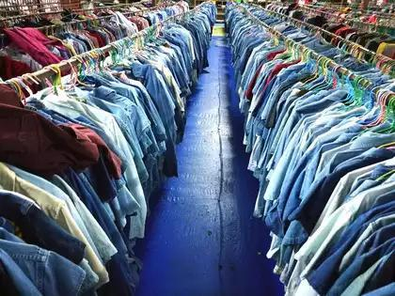
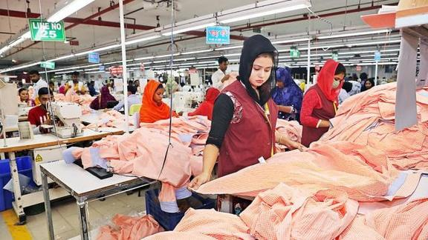

UNDERSTANDING PERSONAL SELLING AND NEGOTIATION
Key Features of Negotiation
Pricing Flexibility
Volume and Order SizeC
ompliance and Standards
Key Features of Personal Selling
Relationship Building
Credibility and Reputation
Follow-Up and Service

Slide 4









READY - MADE GARMENT INDUSTRY
and it’s impact on the economy of Bangladesh
Crucial for both global and local economy
Second-largest garment exporter globally (after China)
Prominent Garment Companies
Ha-Meem Group: Denim and woven garments for Gap, H&M
Beximco Textile: High-quality textiles for Zara, Calvin Klein
DBL Group: Knitwear for Puma, H&M
Square Fashions: Knit and woven garments for Marks & Spence

Slide 5








Personal selling in
Ready Made Garment Industry
Selling to International Buyers (B2B)
Role of Sales Representatives
Using Digital Tools in Personal Selling
Selling in Local Markets (Retail)
Challenges in Personal Selling

Slide 6




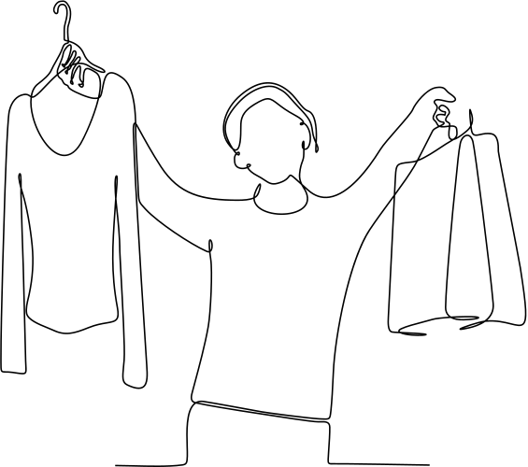





NEGOTIATION TACTICS
Focus on Value, Not Just Price
Use Data to Your Advantage
Be Flexible with Pricing
Build Personal Relationships
Provide Tailored Solutions
Leverage Technology
Showcase Your Supply Chain Strengths
Understand Buyer Motivations

Slide 7




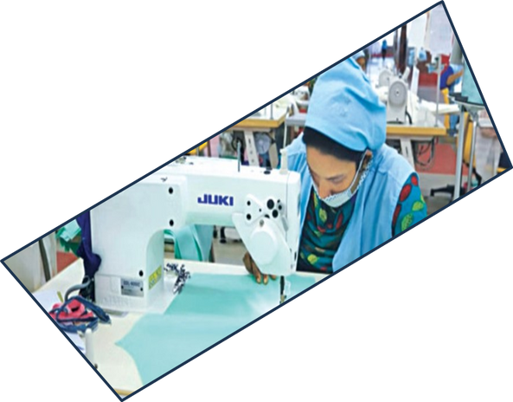


ROLE OF TECHNOLOGY IN PERSONAL SELLING AND NEGOTIATION
Digital Communication Tools
Customer Relationship Management (CRM) Systems
Social Media and Digital Marketing
Virtual Showrooms and Trade Shows
E-Commerce and Online B2B Platforms
3D Virtual Sampling and CAD Technology

Slide 8


CHALLENGES
FACED BY SALES TEAM
Intense Global Competition
Changing Buyer Preferences
Supply Chain Disruptions
Political and Economic Instability
Technological Limitations
Environmental Concerns

Slide 9
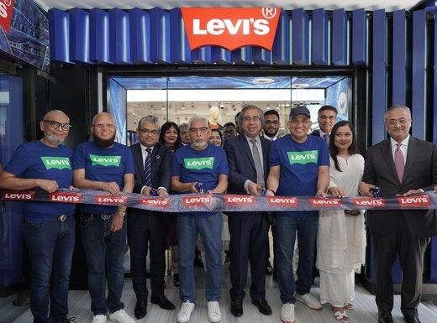
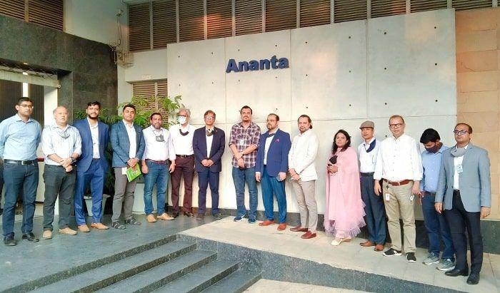
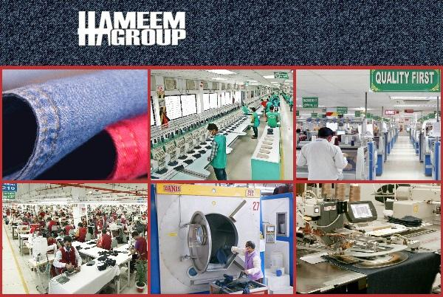


Flexible Pricing
Timely Delivery
Product Quality Assurance
Transparent Communication
SUCCESS STORIES
and best practices

Slide 10




Future of Personal Selling
Evolving Buyer Expectations
Digitalization of the Sales Process
Skill Development for Sales Teams

Slide 11
THANK YOU

